Slide 1
Youth ‘on the fringe’ and radicalization: identifying risk factors in sports

Slide 2
The National Plan for Ethics in Sport (NPES) is an initiative of the Constitutional Government of Portugal, promoted in the Portuguese Institute of Sports and Youth (IPDJ). NPES was launched on February 27, 2012
General Goal
The NPES aims to encourage all citizens, particularly children and young people, to experience ethical values such as respect, honesty, tolerance and solidarity in sports and sports practice.
Vision
«Sport as a powerful tool for human development and a privileged space for the transmission of ethical values.»
"The educational and ethical potential of sport as a school of life is endless."

Slide 3
National Plan for Ethics in Sport (NPES)
Aim to promote Sports with ethical values, based on Fair Play. A fair, loyal, “clean” and respectful Sport. It seeks to combat the problematics associated to sport (violence, doping, corruption, etc.)
NPES defends that through sports, its possible to experience and assimilate Principles and Values that, properly framed, help to build character and improve soft skills. Those are extendable to all other dimensions of life (school, work, family, community).
In Sports as in Life… .. In Life as in Sports!

Slide 4
PREVENTIVE APPROACH
EDUCATIONAL DIMENSON OF SPORT
NPES Strategical Axes
Training & Education
Contests
(secondary schoo; media; university; prisons
Sport Pratices & Events
Campaigns
Publications, Research and Digital Platforms

Slide 5
Training & Education
Inclusion of the Ethics in Sport topic at various levels of training, particularly in specialized training for teachers of primary and secondary education, and in specialized training of several sports agents (sports directors and coaches). Development of awareness sessions about the Ethics in Sport theme in schools, sport clubs and other entities, with children, young people and parents.

Slide 6
Violence
- This subject is approached in all the training and awareness sessions, naturally adapted to the different target groups.
All types of violence – verbal, emotional and physical are approached.
NPES is a promoter of a campaign against Bullying in sport – RED CARD to Bullying. This campaign has made way to a project – Sport without Bullying- where NPES is promoter in a partnership with a University (Faculty of Human Motricity).
Production and distribution of a flyer related to Bullying in sport . (bullying is several times the first step to other types of violence)
NPES is a partner of a campaign against violence in sport. This campaign is promoted directly by the Portuguese government – ZERO Violence. Most of the resources and contents available in the ZERO Violence website are from NPES.
Articulation with the recent Prevention and combat to violence in sport Authority (APCVD), where NPES will promote training and awareness sessions in clubs punished/sanctioned by violence cases.

Slide 7
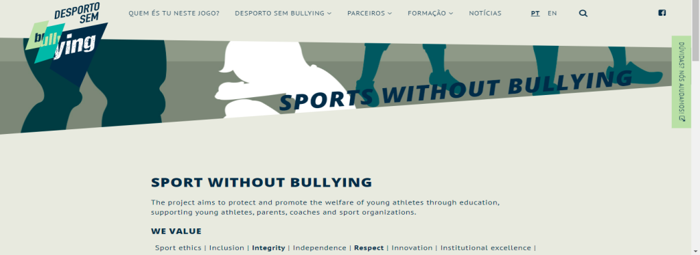
http://www.desportosembullying.pt/sports-without-bullying/

Slide 8
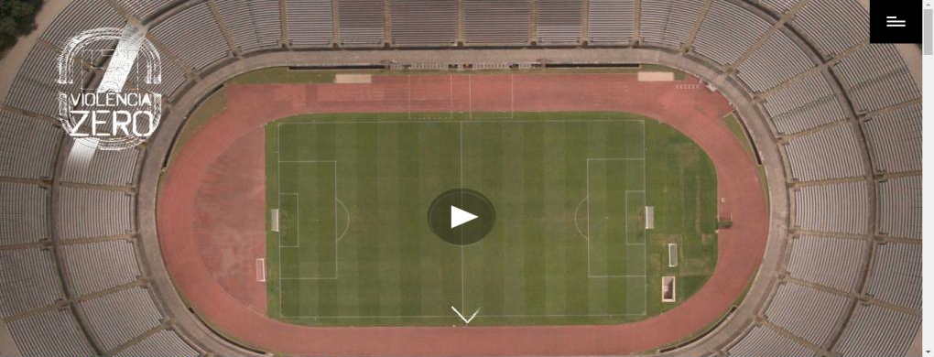
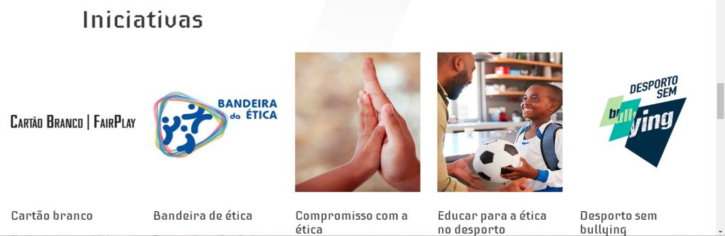
https://www.violenciazero.gov.pt/pt

Slide 9
Ethics in sport in MEDIA
NPES have a regular presence on Media (newspapers, TV and digital platforms) promoting sport ethic and sport values
A bi-weekly article on a portuguese sport newspapper

Slide 10
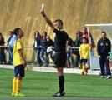
Projects and good practices
Ethics Flag - It is a certification process of ethical values in sport, addressed to any type of entity that want to see their work, in the promotion of ethical values through sport, recognized and certified. It is also intended to implement a process that identifies and promotes good practices, while ensuring a flexible and useful methodology for all types of agents.
White/Fairplay Card - White card recognizes, highlight and reward the ethical relevant attitudes and behaviors practiced by athletes, trainers, leaders, among other staff directly involved in the game, and the spectators. It is a pedagogical card.

Slide 11
www.pned.ipdj.gov.pt
PNEDesporto
pned@pned.pt
pned.ipdj
Thank you for your attention!
André Xavier de Carvalho
andre.carvalho@pned.pt

